Slide 1
Cross-lingual Structure Transfer for Relation and Event Extraction
Di Lu, Ananya Subburathinam and Heng Ji
University of Illinois at Urbana-Champaign
hengji@illinois.edu

Slide 2
Information Extraction as Information Network Construction
Relation Extraction
Event Extraction (Trigger Labeling + Argument Role Labeling)

Slide 3
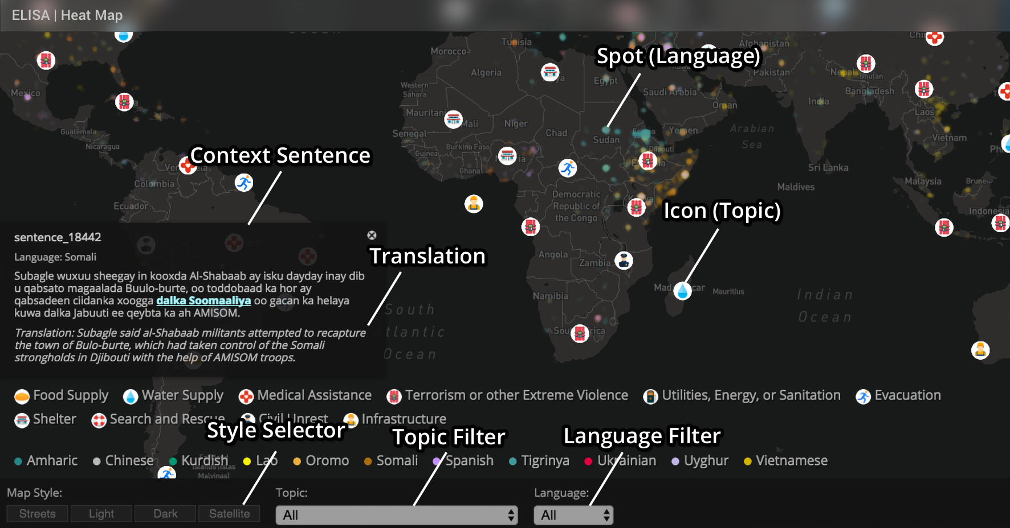
Applications: Disaster Relief
Re-trainable Systems: http://blender02.cs.rpi.edu:3300/elisa_ie/api
Data and Resources: http://nlp.cs.rpi.edu/wikiann/
Demos: http://blender02.cs.rpi.edu:3300/elisa_ie http://blender02.cs.rpi.edu:3300/elisa_ie/heatmap

Slide 4
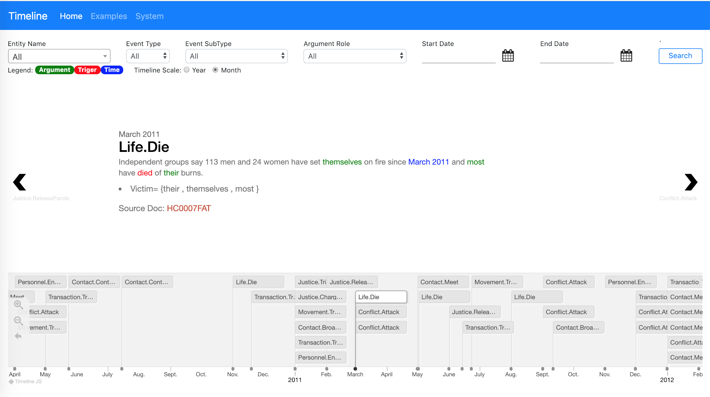
Applications: Event Tracking
https://blender04.cs.rpi.edu/~lim22/gaia/GAIA_arg.html

Slide 5
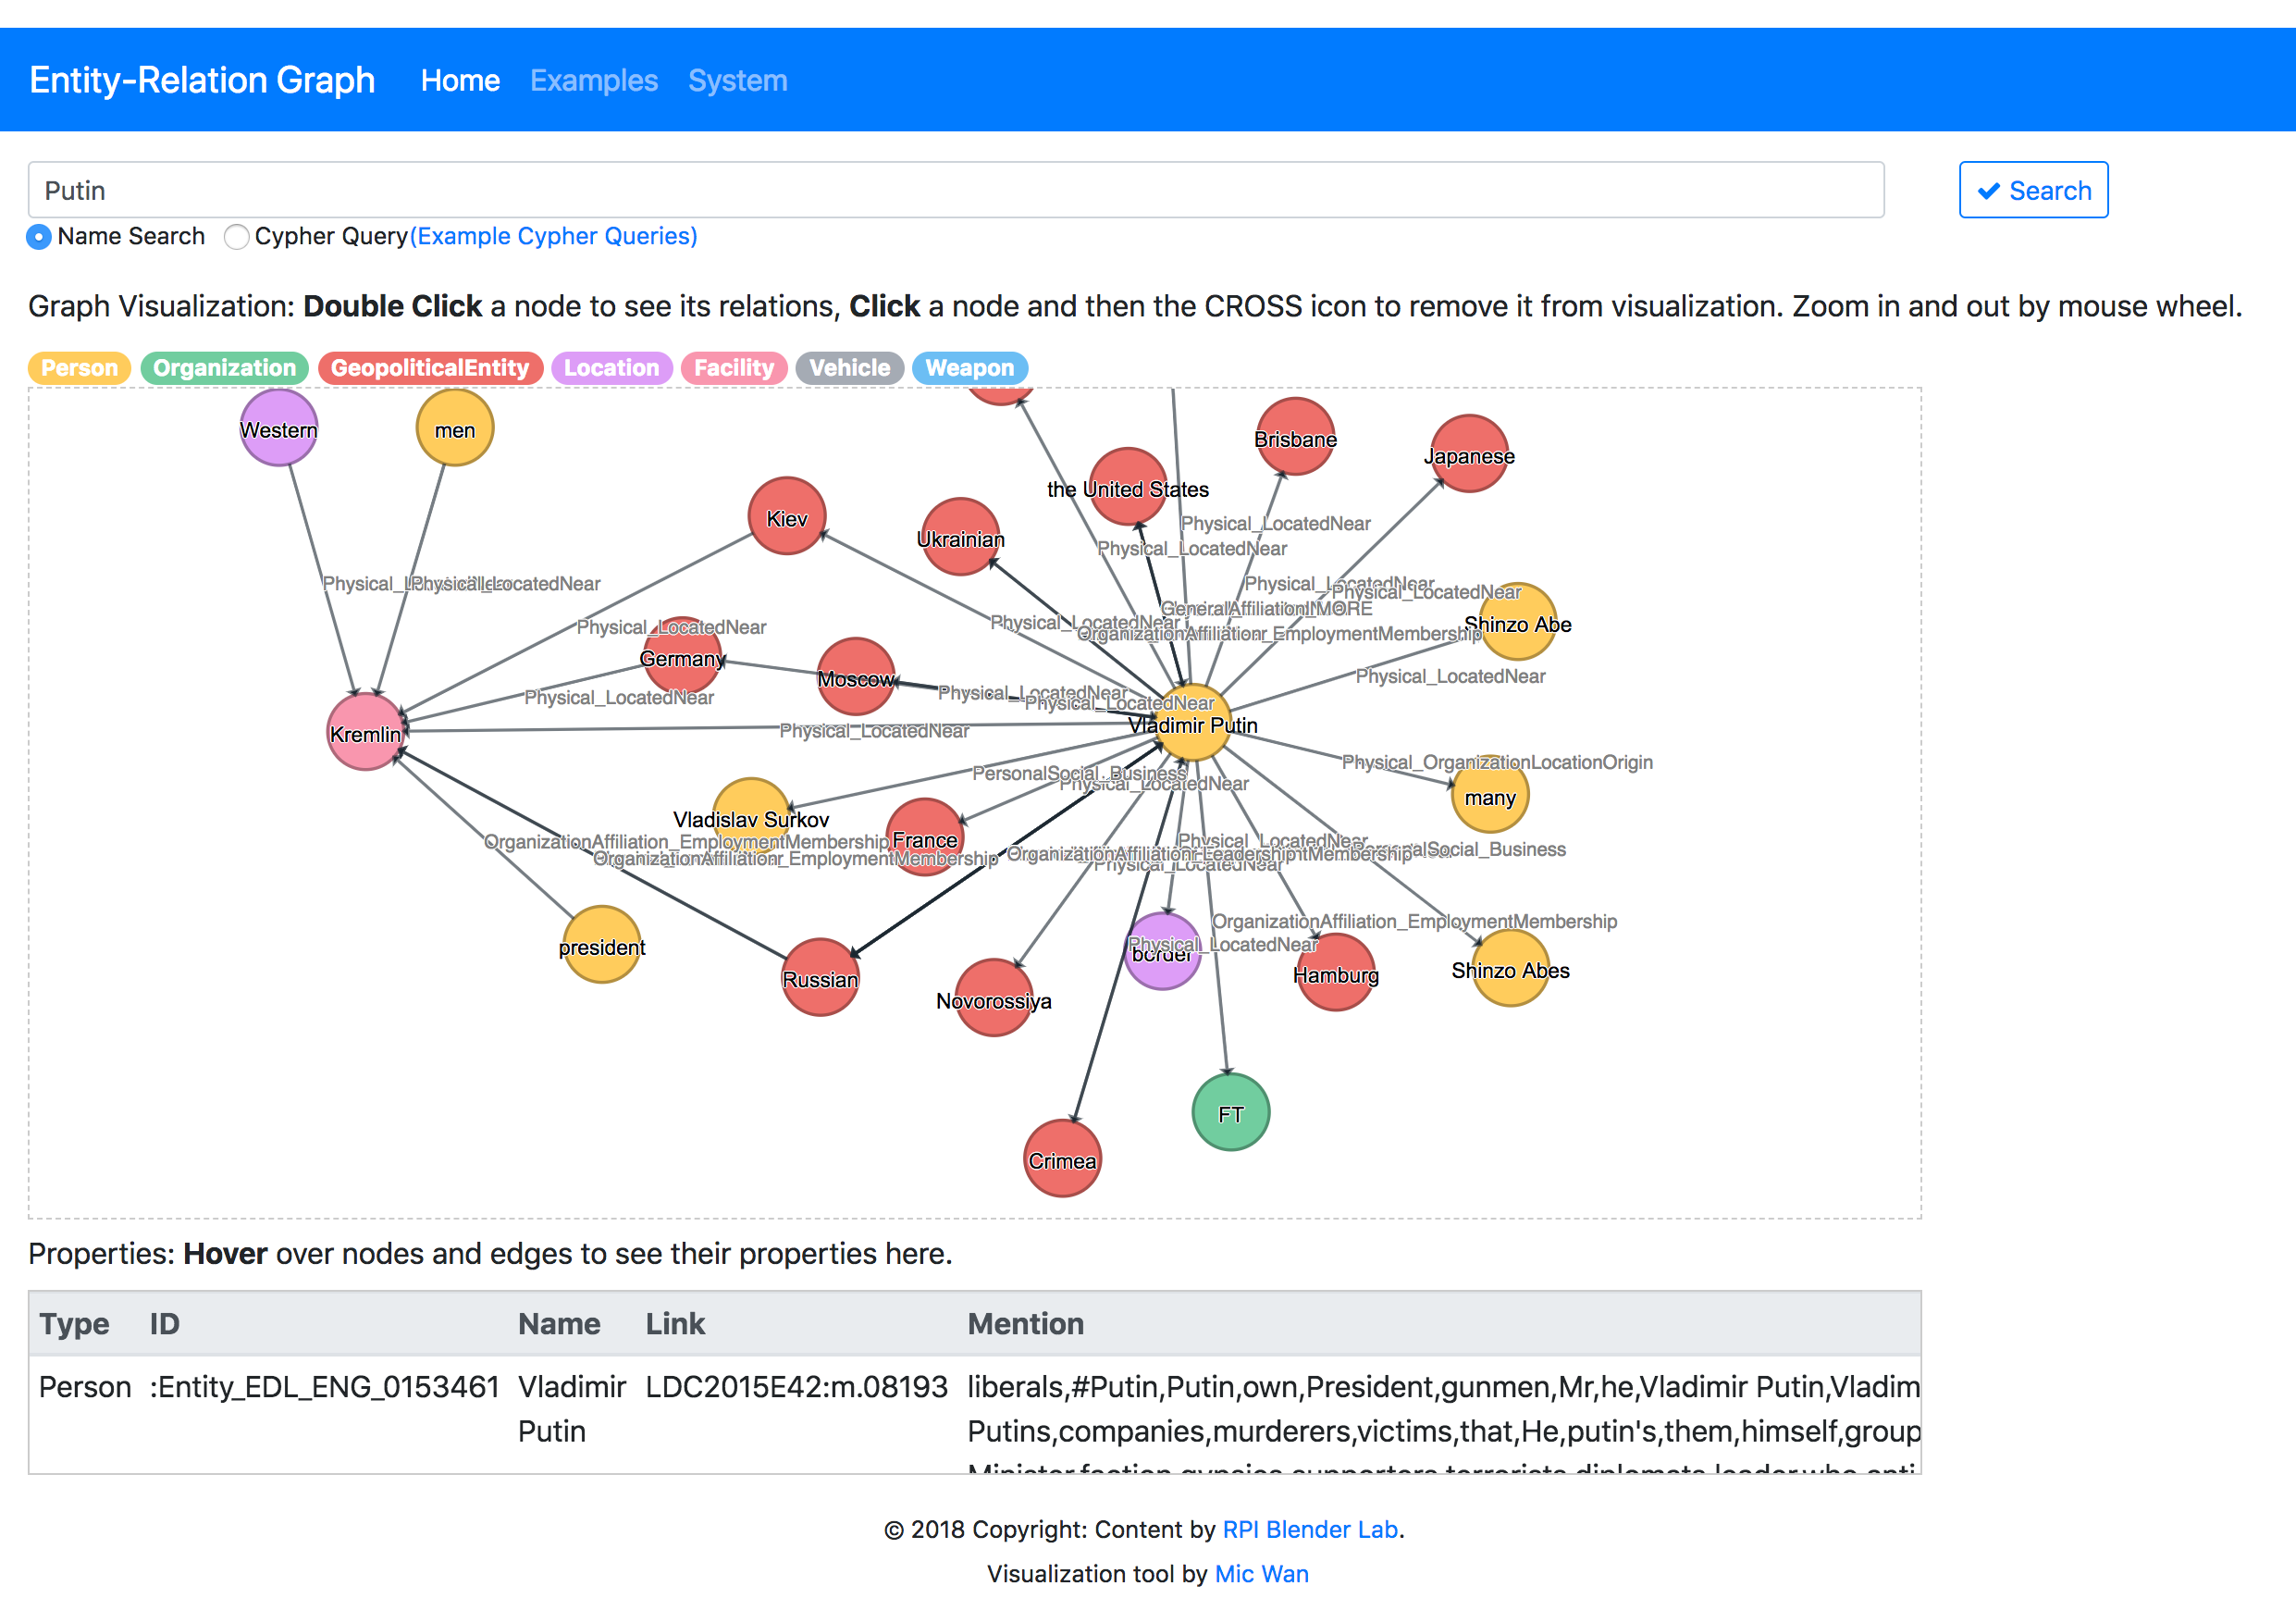
Applications: Entity Relation Tracking
https://blender04.cs.rpi.edu/~lim22/entity_demo/aida_index.html

Slide 6
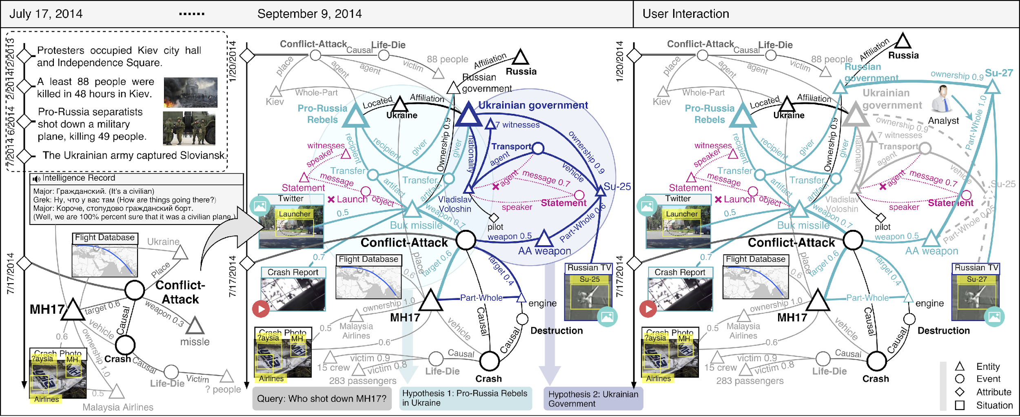
Applications: Intelligence Analysis

Slide 7
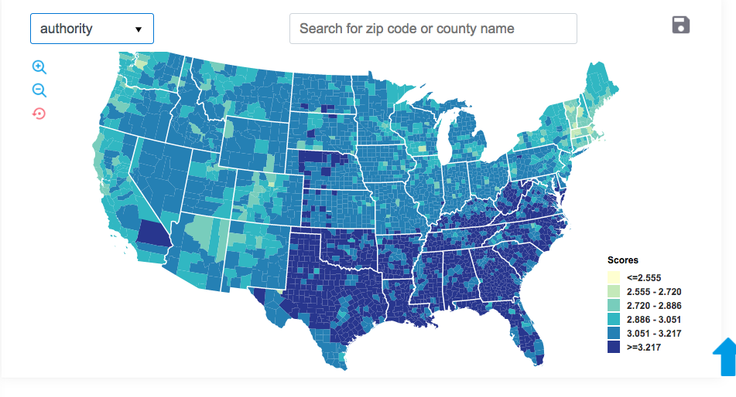
Applications: County-Level Moral Concerns
(Mooijman et al., Nature Human Behavior 2018, June Cover)

Slide 8
Applications: Ukraine Event and Moral Value Map
http://162.243.120.148:8080/
Achievement, Benevolence, Conformity, Hedonism, Power, Security, Self-direction, Simulation, Tradition and Universalism (Schwartz, 2012)

Slide 9
Applications: PaperRobot
Turing test passing rate up to 30%

Slide 10
Dilemma of Information Need vs. Resource Constraint
Certain relations and events are reported predominantly in local news in low-resource languages
e.g., the vast majority of Physical-Located relations and Meeting events involving Aung San Suu Kyi are only reported locally in Burmese news
Publicly available gold-standard annotations for relation and event extraction exist for only a few languages
More expensive than name tagging because relations/events are structured and require a rich label space – not suitable for crowd-sourcing

Slide 11
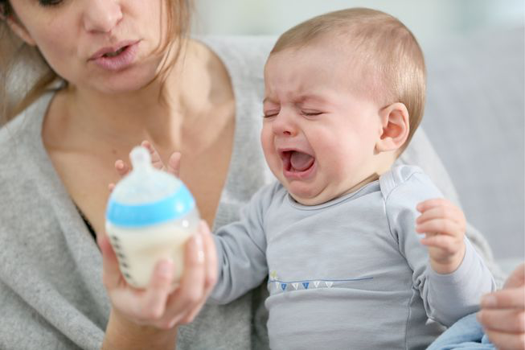
One Possible Solution: Share and Transfer
Enhance Quality with deep knowledge acquisition and reasoning
Transfer knowledge across domain/genre/language/data modality

Slide 12
Previous Work
Multilingual common space construction makes use of linear mappings (Mikolov et al., 2013; Rothe et al., 2016; Zhang et al., 2016; Baroni et al., 2015; Xing et al., 2015; Smith et al., 2017) or canonical correlation analysis (CCA) (Ammar et al., 2016; Faruqui and Dyer, 2014; Lu et al., 2015) to transfer surface features across languages
Cross-lingual IE work mainly focuses on sequence labeling (name tagging) (Mayhew et al., 2017; Lin et al., 2018; Huang et al., 2019) which is not significantly influenced by word order

Slide 13
Toward more Structured Representations
Hypothesis: Relational facts are typically expressed by identifiable patterns which are consistent across languages (Lin et al., 2017)
Language-universal symbolic representations
POS tagging and dependency parsing are available for 84 languages (Nivre et al., 2018)
Entity extraction is available for 282 languages (Pan et al., 2017)
Language-universal distributional representations
multi-lingual word embedding is available for 44 languages (Bojanowski et al., 2017; Joulin et al., 2018)

Slide 14
Cross-lingual Structure Transfer Learning
Adopt graph convolutional networks (GCN) (Kipf and Welling, 2017; Marcheggiani and Titov, 2017) to encode graph structures over the input data, applying graph convolution operations to generate entity and word representations in a latent space
Project all entity mentions, event triggers and their contexts in source language (SL) training data and target language (TL) test data into one multilingual common semantic space
Treat the two tasks of relation extraction and argument role extraction as mappings from the latent space to relation type and to event argument role, respectively
Train a relation or event extractor from SL annotations and apply the resulting extractor to TL texts

Slide 15
Toward more Structured Representations

Slide 16
Graph Convolutional Networks (GCN) Encoder
Extend the monolingual design (Zhang et al., 2018) to cross-lingual
Convert a sentence with N tokens into N*N adjacency matrix A
Node: token, each edge is a directed dependency edge
Initialization of each node’s representation
At the k^{th} layer, derive the hidden representation of each node from the representations of its neighbors at previous layer
Word embedding
POS tag
Dependency relation
Entity type

Slide 17
Application on Relation Extraction
Task: Classify each pair of entity mentions into one of pre-defined relation types or NONE
Max-pooling over the final node representations to obtain representations for sentence and two entity mentions, and concatenate them
A softmax output layer for relation type classification

Slide 18
Application on Event Argument Extraction
Task: Classify each pair of event trigger and entity mentions into one of pre-defined event argument roles or NONE
Max-pooling over the final node representations to obtain representations for sentence, trigger and argument candidate, and concatenate them
A softmax output layer for argument role labeling

Slide 20
Data
Automatic Content Extraction (ACE) 2005 corpus for English, Chinese and Arabic
7 entity types, 18 relation subtypes and 33 event subtypes
Random split: 80% for training, 10% for development and 10% for blind test
Tokenization: Stanford CoreNLP (Manning et al., 2014) for English and Chinese; UDPipe (Straka and Strakova, 2017) for Arabic
POS tagging and dependency parsing using UDPipe for all three languages

Slide 21
Overall Performance
Relation Extraction
Event Argument Extraction
Much better than state-of-the-art on cross-lingual transfer (47.7%, Hsi et al., 2016)

Slide 22
Ablation Study
Relation Extraction
Event Argument Extraction

Slide 23
Comparison with Supervised Approach
Chinese Relation Extraction

Slide 24
Comparison with Supervised Approach
Arabic Relation Extraction

Slide 25
Comparison with Supervised Approach
Chinese Event Argument Extraction

Slide 26
Comparison with Supervised Approach
Arabic Event Argument Extraction

Slide 27
Which Types Benefit Most from Cross-lingual Structure Transfer?
Require deep understanding of wide contexts involving complex syntactic and semantic structures
PART-WHOLE:Artifact, PARTWHOLE:Geographical, GEN-AFF:Org-Location, ORG-AFF:Employment relations
Injure:Victim argument role
Event argument roles for which entity type is a strong indicator
a weapon is much more likely to play as an Instrument rather than a Target in an Attack

Slide 28
Related Work
Cross-lingual structure transfer rely on bilingual dictionaries (Hsi et al., 2016), parallel data (Chen and Ji, 2009; Kim et al., 2010; Qian et al., 2014) or machine translation (Faruqui and Kumar, 2015; Zou et al., 2018)
(Lin et al., 2017; Wang et al., 2018c) aggregate consistent patterns and complementary information across languages to enhance Relation Extraction, but they exploit only distributional representations

Slide 29
Ongoing Work: Multimedia Common Space
Treat Image/Video as a foreign language

Slide 30
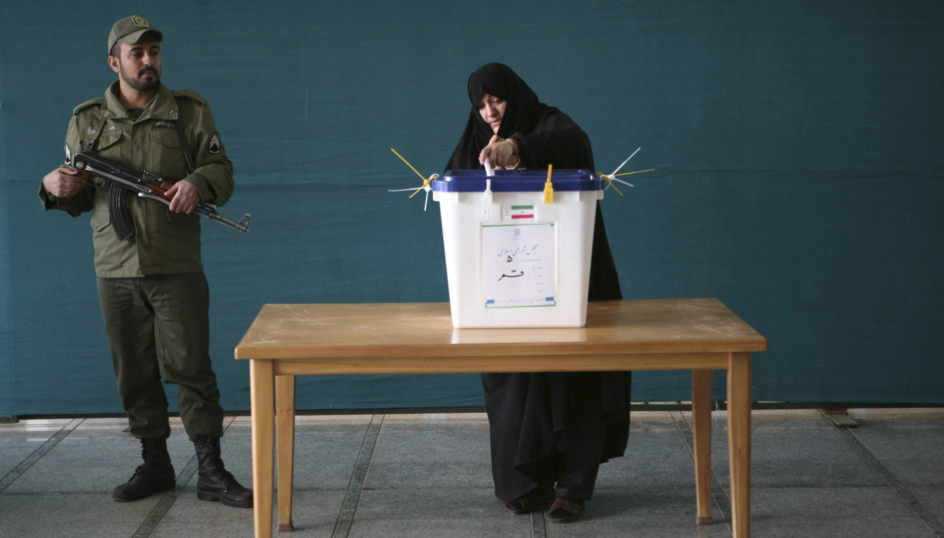
Ongoing Work: Cross-media Transfer Learning
Parliamentary elections was held on March 2.
Forty-three people died in the crash.
Contemporary journalism often distributes news content via multimedia
“rise of the image, and fall of the word” (Stephens, 1998)
Visual concepts can fill in missing argument roles: voter, instrument, …
30
Notes:
Change low resource IL to a language which is not in wikipedia
Word-level: from bi-lingual dicts and alignment; structure-level comes from wals; multi-level alignment

Slide 31
Ongoing Work: Cross-media Transfer Learning

Slide 32
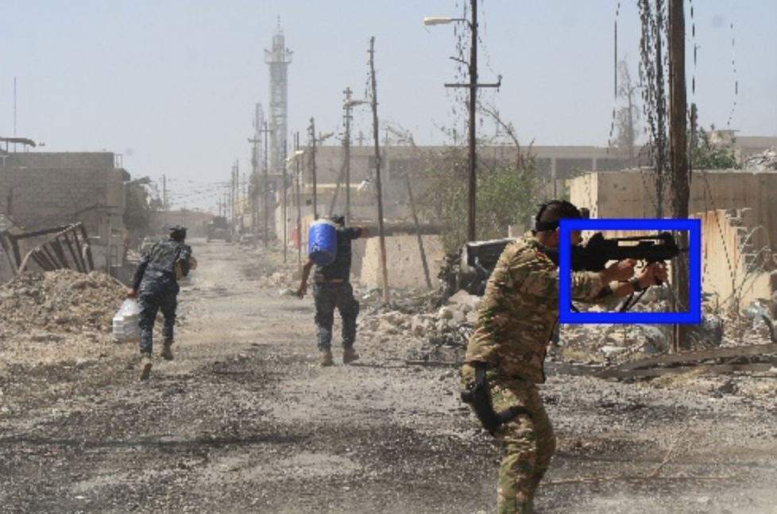
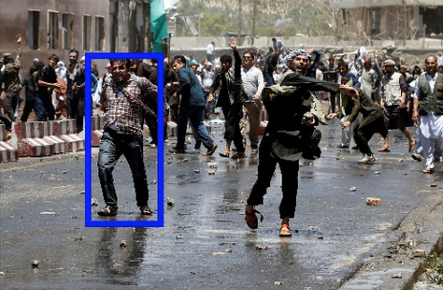
Example Output
Image Event Extraction Results
Baseline:
Event: Justice:Arrest-Jail
Roles:
None
Our Approach:
Event: Conflict.Attack
Roles:
Instrument = weapon
Baseline:
Event: Justice:Arrest-Jail
Roles:
Entity = man
Our Approach:
Event: Conflict:Demonstrate
Roles:
Entity = man
Baseline:
Event: Justice:Arrest-Jail
Roles:
Agent = man
Our Approach:
Event: Justice:Arrest-Jail
Roles:
Person = man

Slide 33
Some IE Demos

Slide 34
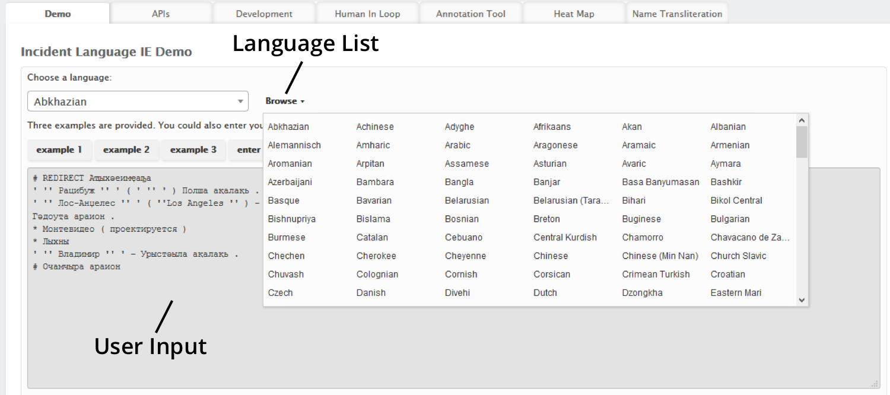
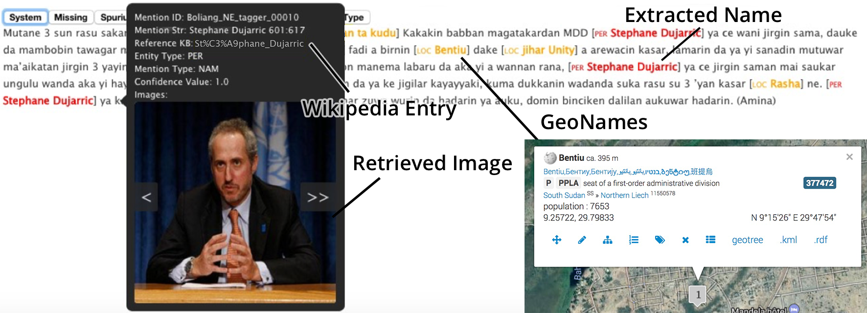
Cross-lingual Entity Discovery and Linking for 282 Languages
(Pan et al., ACL2017)
Selected for DARPA60

Slide 35
Cross-document Event Tracking
https://blender04.cs.rpi.edu/~lim22/gaia/GAIA_arg.html

Slide 36
Cross-document Entity Relation Tracking
https://blender04.cs.rpi.edu/~lim22/entity_demo/aida_index.html

Slide 37
Disaster Relief
Re-trainable Systems: http://blender02.cs.rpi.edu:3300/elisa_ie/api
Data and Resources: http://nlp.cs.rpi.edu/wikiann/
Demos: http://blender02.cs.rpi.edu:3300/elisa_ie http://blender02.cs.rpi.edu:3300/elisa_ie/heatmap

Slide 38
Ukraine Event and Moral Value Map
http://162.243.120.148:8080/
Achievement, Benevolence, Conformity, Hedonism, Power, Security, Self-direction, Simulation, Tradition and Universalism (Schwartz, 2012)
http://162.243.120.148:8080/

Slide 39
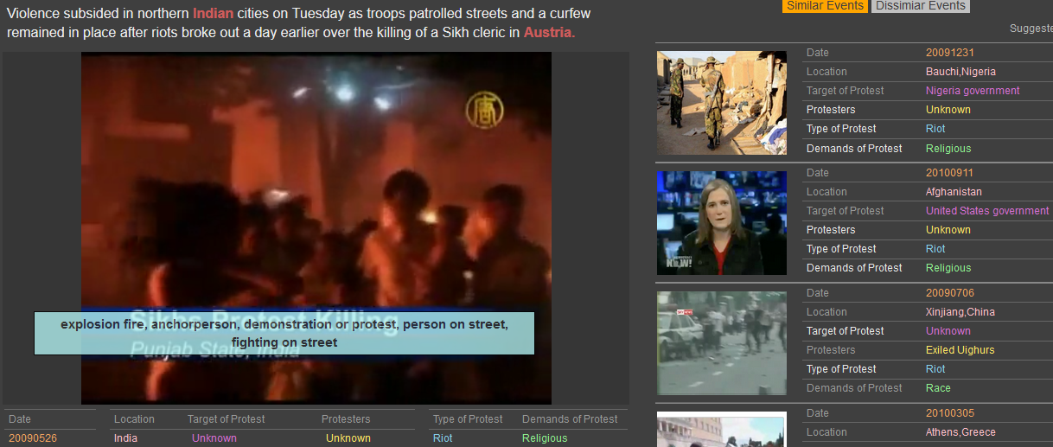
Event Recommendation
Cross-media coreference and inference
http://nlp.cs.rpi.edu/multimedia/event2017/navigation_dark.html
39

Slide 40
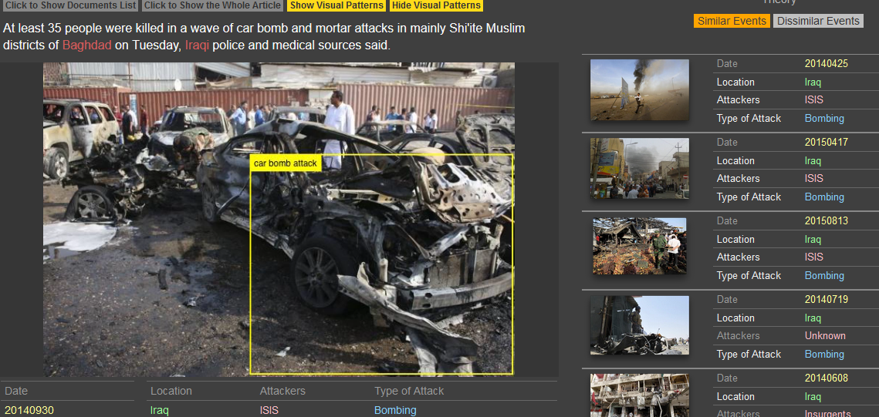
Event Recommendation
Visual Pattern Discovery and Naming;
Cross-media Event Schema Discovery
40

